Slide 1
IchigoJam first step
Blink the LED
(Hit the Space key to input space)
Light up the LED
10 LED1:WAIT30
20 LED0:WAIT30
30 GOTO10
RUN
LED1
Type “LED1” and hit the Enter.
Light off the LED
LED0
Every line needs to hit the Enter.
“RUN” is a command to start your program.
Hit the ESC key to stop the program.
Also the F5 key is same as “RUN”.
Order your computer to wait for a while
WAIT120
“LIST” is a command to display the program.
LIST
The F4 key works same way.
“WAIT120” means “wait 2sec” Q:”WAIT60” means?
Can you blink the LED more fast?
The Enter to tell computer your modification.
WAIT60
:
You can save up to four programs (0 to 3)
Light up the LED 1sec ( to connect commands)
SAVE0
The F3 key types “SAVE”.
LED1:WAIT60:LED0
After reboot your computer,
you can load that program.
Hit the UP key twice.
Hit the RIGHT key 12 times.
Hit the Backspace key to delete “6”.
Type “12”. Hit the Enter to modify your order.
LOAD0
The F2 key types “LOAD”.
Type “NEW” to clear your program.
LED1:WAIT120:LED0
NEW
http://ichigojam.net/

Slide 2
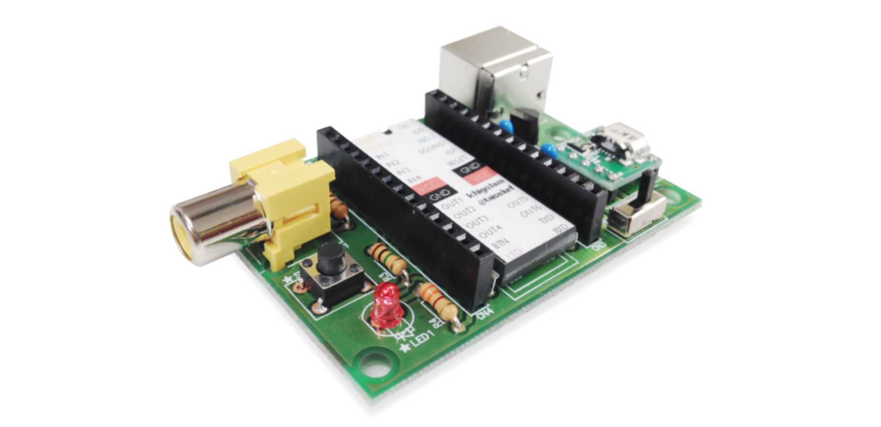
IchigoJam mini games
Rafting! (The RIGHT and the LEFT key to avoid)
Baseball! (Hit any key to hit the ball)
10 CLS:X=15
20 LC X,5:?”O”
30 LC RND(32),23:?”*”
35 WAIT 3
36 X=X-BTN(28)+BTN(29)
37 IF SCR(X,5) END
40 GOTO 20
10 LET Y,0
20 CLS
30 LC 4,15:?”%”
40 LC 5,Y:?”O”
50 IF INKEY() GOTO 90
60 LET Y,Y+1
70 WAIT 6
80 GOTO 20
90 IF Y=15 ?”HIT!”
How fast? (Hit the Space key after lighting up LED)
10 LED 0
20 WAIT RND(180)+60
30 LED 1:CLT
40 IF BTN(32)=0 GOTO 40
50 ?TICK()
Screen jack! (Hit any key)
10 LET C,1:CLS
20 LC RND(32),RND(22)
30 ?CHR$(C)
40 LET K,INKEY():IF K C=K
50 GOTO 20
Type! (Type in A to Z)
10 LET N,65:CLT
20 ?CHR$(N);
30 IF INKEY()!=N GOTO 30
40 LET N,N+1:IF N<91 GOTO 20
50 ?:?TICK()/60
Hit the Shift key to type ‘(‘, ‘)’ or ‘”’
shift
+
(
9
Calc! (Calculate the sum quickly)
10 LET N,0:CLT
20 LET A,RND(10)
30 LET B,RND(10)
40 ?A;”+”;B;”=“;:INPUT C
50 IF C!=A+B ?”NG!”:END
60 LET N,N+1:IF N<10 GOTO 20
70 ?TICK()/60
http://ichigojam.net/

