Slide 1
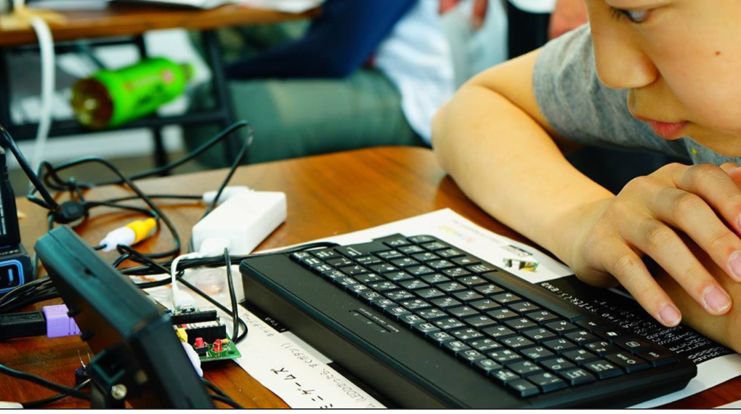
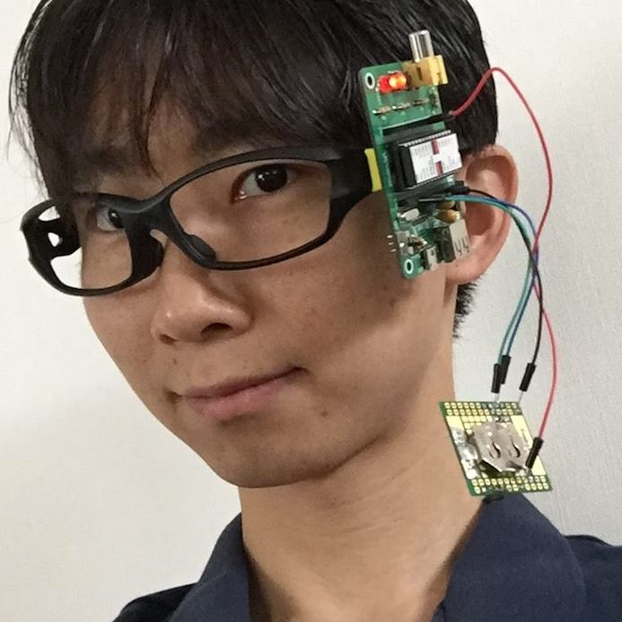
The first programming
with IchigoJam
福野泰介 (Taisuke Fukuno) PCN
@taisukef http://fukuno.jig.jp/

Slide 2
IchigoJam $15

Slide 3
2 meanings
Ichi:1, Go:5 ・・・ $15 computer
Ichigo(イチゴ）@ja = strawberry@en

Slide 4
Let’s talk to
the computer!

Slide 5
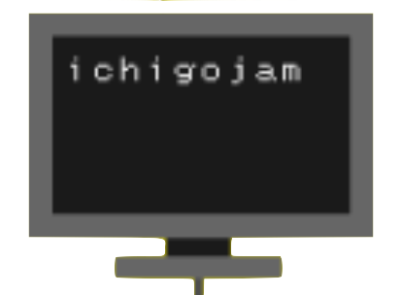
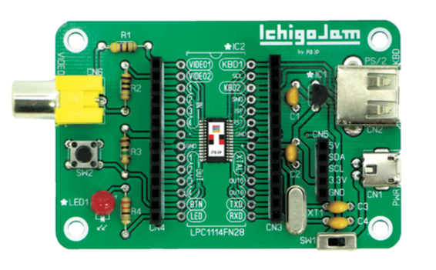
1.TV
How to connect IchigoJam
3.keyboard
4.AC adapter
100均(200円)
家庭のテレビか
4.3インチオンダッシュモニターなど
サンワサプライ SKB-L1UBK (PS/2対応USBキーボード)
2.Video
cable
5.microUSB
cable
100均
ON
100均

Slide 6
IchigoJam BASIC
OK
A white box: the cursor

Slide 7
…
(I don’t
have ears)
“Hey Light up the LED”

Slide 8
IchigoJam BASIC
OK
A
Type in “A” using the keyboard

Slide 9
IchigoJam BASIC
OK
A
A
Enter key

Slide 10
IchigoJam BASIC
OK
A
Syntax error
A
エンターキー

Slide 11
?
I don’t
know
A
Syntax error
(A, the Enter key)

Slide 12
IchigoJam BASIC
OK
LED1
A
Enter key

Slide 13
!
*
I know it!
OK
LED 1

Slide 14
!
I know it!
OK
LED 0

Slide 15
second command
CLS

Slide 16
Also “F1”
CLS

Slide 17
「:」colon is 「.」period
in BASIC language
LED1:LED0

Slide 18
LED1:LED0
OK
？

Slide 19
Do you know
speed of computers?

Slide 20
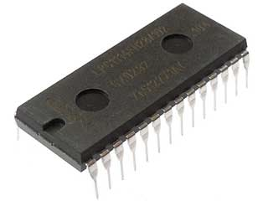
1$ CPU
How many times can it calculate in 1 second?
Image: LPC1114 秋月電子

Slide 21
50,000,000 times!
（５千万回）
(ARM RISC CPU, maximum clock: 50MHz)
Image: LPC1114 秋月電子

Slide 22
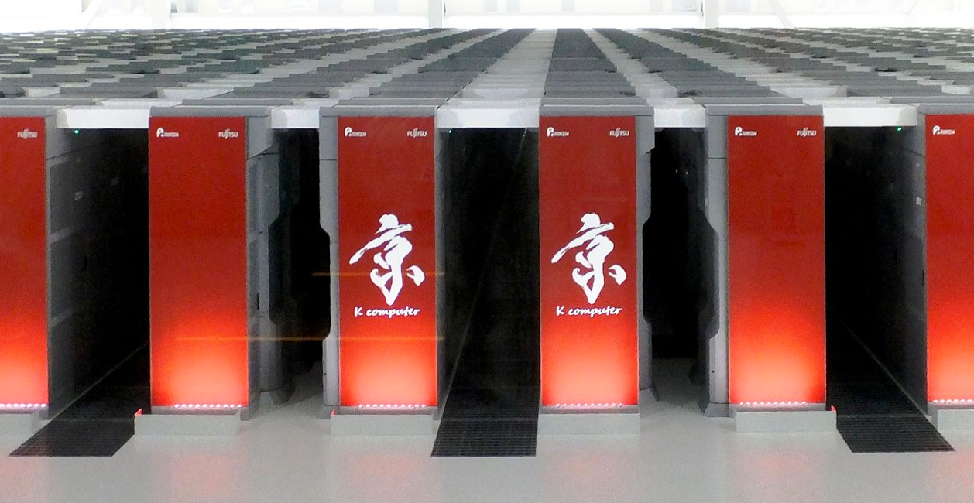
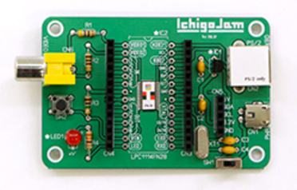
(C)TSUKUMO
from Wikipedia
(C)Apple
IchigoJam | iPhone | PC | super computer
50M 5000万回 | 40G 400億回 | 10T 10兆回 | 10P 1京回
IchigoJam 何台分？→ | x600 600台分 | x200,000 20万台分 | x200,000,000 2億台分
1500yen | 70kyen | 100kyen | 112Myen

Slide 23
freeze!?
WAIT600

Slide 24
60 = 1 second
WAIT60

Slide 25
use cursors
A
LED1:WAIT60:LED0

Slide 26
Blink 10 times!

Slide 27
LED1:WAIT10:LED0:WAIT10:LED1:WAIT10:LED0:WAIT10:LED1:WAIT10:LED0:WAIT10:LED1:WAIT10:LED0:WAIT10:LED1:WAIT10:LED0:WAIT10:LED1:WAIT10:LED0:WAIT10:LED1:WAIT10:LED0:WAIT10:LED1:WAIT10:LED0:WAIT10:LED1:WAIT10:LED0:WAIT10:LED1:WAIT10:LED0
too long!

Slide 28
B
1 OUT1:WAIT10
2 OUT0:WAIT10
?

Slide 29
show me
Also “F4”
LIST

Slide 30
Do it!
Also “F5”
RUN

Slide 31
GOTO command to go 1
C
3 GOTO1
use “F4” and “F5”

Slide 32
LED GAME
Stop when light up the LED

Slide 33
to stop
[ESC]key
A

Slide 34
Repeating!
1 OUT1:WAIT10
2 OUT0:WAIT10
3 GOTO1
F4 / F5

Slide 35
to save the CPU
“F3” and the Enter
SAVE

Slide 36
1.TV
Turn it off and unplug TV and keyboard
3.keyboard
4.ACadapter
2.Video
cable
5.microUSB
cable
OFF

Slide 37
Pressing the button
and turn it on!
Pressing
the button
Turn it ON

Slide 38
You made T!

Slide 39
Panasonic

Slide 40
All programmed
by someone
画像、LPC1114 秋月電子

Slide 41
Let’s count computers
in your house!

Slide 42
1.TV
How to connect IchigoJam
3.keyboard
4.AC adapter
100均(200円)
家庭のテレビか
4.3インチオンダッシュモニターなど
サンワサプライ SKB-L1UBK (PS/2対応USBキーボード)
2.Video
cable
5.microUSB
cable
100均
ON
100均

Slide 43
To read from CPU
Also “F2”
LOAD

Slide 44
Show me program
Also “F4”
LIST

Slide 45
Let’s make a game!

Slide 46
from scratch
don’t worry
save your saved that
NEW

Slide 47
D
10 CLS:X=16
the first line

Slide 48
Do the program!
Also “F5”
RUN

Slide 49
the command to show me
What will you get?
?X

Slide 50
Show me
Also “F4”
LIST

Slide 51
c
ALT + C
Other characters!

Slide 52
Also “F1”
CLS

Slide 53
1. Hit the Enter key
2. Hit the “F5” key
E
20 LC X,5:?”c”
your character

Slide 54
Enter, F5
F5,F5,F5,,,,
F
30 LC RND(32),23:?”*”
the enemy

Slide 55
ESC key
to stop
G
40 GOTO20
to repeat

Slide 56
ESC: stop
F1: clear
F4: show me
F5: do it
H
35 WAIT3
adjust speed

Slide 57
ESC: stop
F1: clear
F4: show me
F5: do it
I
36 X=X-BTN(28)+BTN(29)
control

Slide 58
ESC: stop
F1: clear
F4: show me
F5: do it
J
38 IF SCR(X,5) END
Hit check

Slide 59
ESC: stop
F1: clear
F4: show me
F5: do it
K
37 X=X&31
prevent cheat

Slide 60
L
10 CLS:X=16
20 LC X,5:?”c”
30 LC RND(32),23:?”*”
35 WAIT 3 36 X=X-BTN(28)+BTN(29)
37 X=X&31
38 IF SCR(X,5) END
40 GOTO 20
next scene…
It’s the standard!

Slide 61
The Enter key
after changing
M
10 CLS:X=16:CLT
20 LC X,5:?”j”
30 LC RND(32),23:?”eee”
35 WAIT 10
36 X=X-BTN(28)+BTN(29)
37 X=X&31
38 IF SCR(X,5) ?TICK():END
40 GOTO 20
Calculate your concentration

Slide 62
Let’s make a robot!

Slide 63
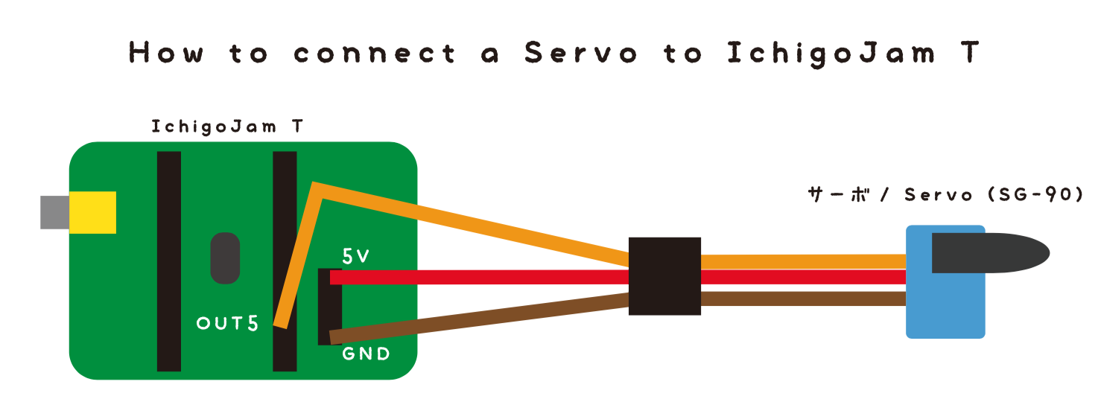
PWM5,140:WAIT30:PWM5,50
N
OUT5 - Orange
5V - Red
GND - Brown

Slide 64
1 PWM 5,140:WAIT10
2 PWM 5,100:WAIT10
3 IF BTN()=0 CONT
4 GOTO1
O
move!
button to stop

Slide 65
10 WAIT60*3
20 PWM 5,140:WAIT60
30 PWM 5,50:WAIT60
40 IF BTN() END
50 GOTO20
O
Alarm robot
You will beaten up by the server
after 3 seconds
button to stop

Slide 66
Sounder
30yen
P
BEEP
BEEP 5
BEEP 10,30
PLAY”CDE”
SOUND
(SND)
GND

Slide 67
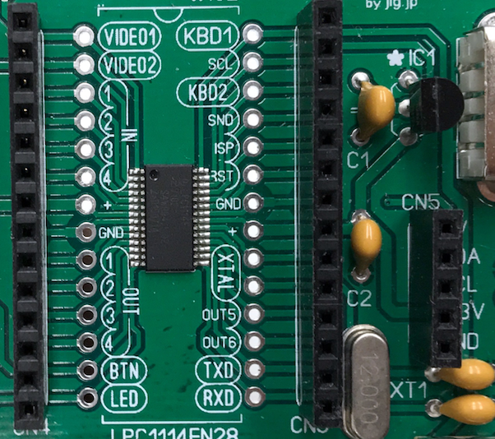
Temperature sensor
Q
10 OUT1,-1:OUT2,1
20 ?ANA(5)
30 WAIT10:GOTO20
GND
OUT1
OUT2 (VCC)

Slide 68
Turn on when hot!
R
10 OUT1,-1:OUT2,1
15 LED0
20 ?ANA(5)
25 IF ANA(5)>290 LED1
30 WAIT10:GOTO20

Slide 69
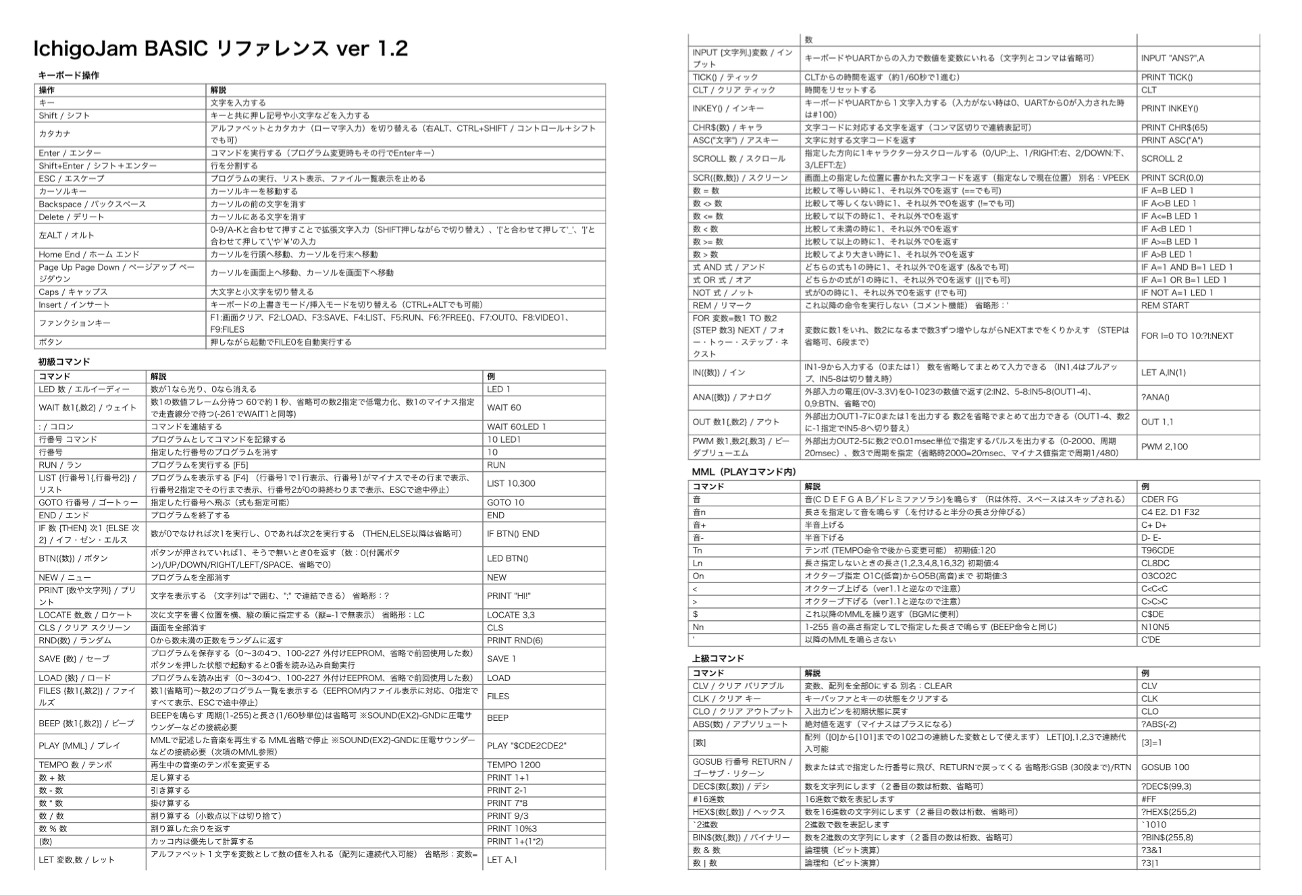
http://ichigojam.net/IchigoJam.html
Thin reference

Slide 70
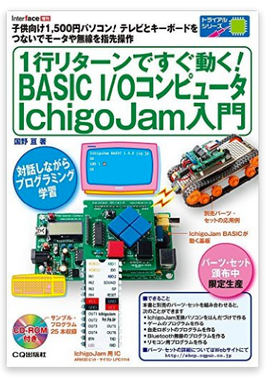
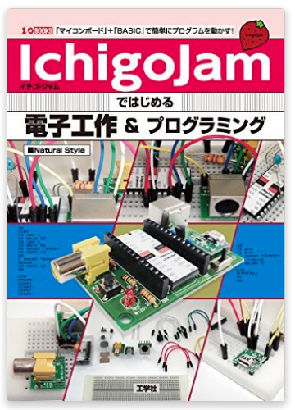
Many samples

Slide 71
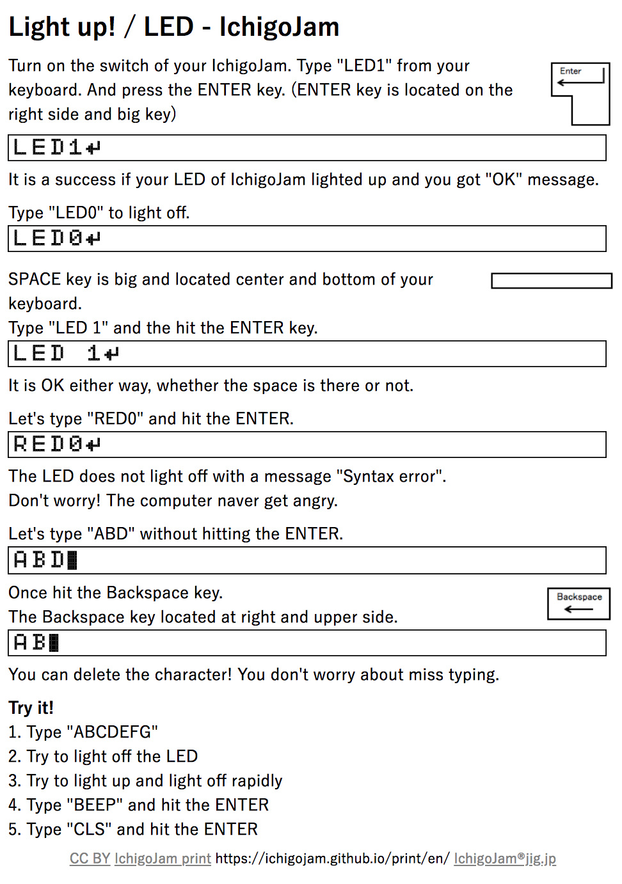
IchigoJam print
simple open text on net / GitHub
https://ichigojam.github.io/print/en/
learn how to learn

Slide 72
You can begin from the zero (soldering)
IchigoJam

Slide 73
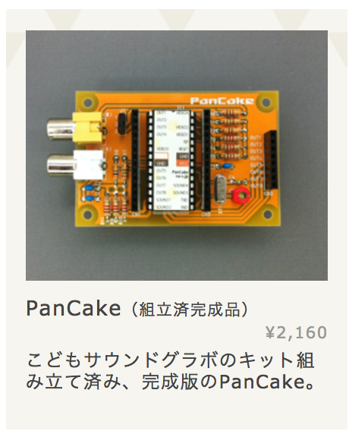
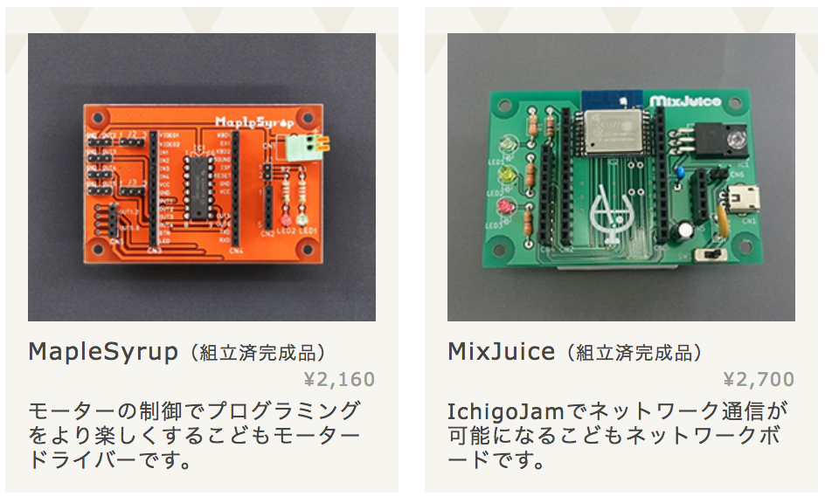
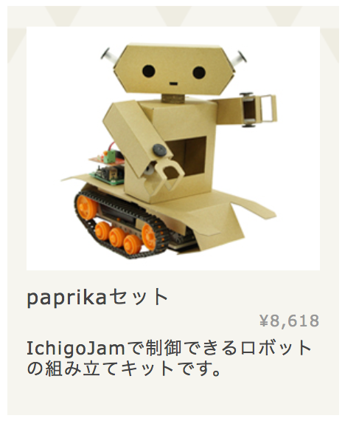
Many expansions!
http://pcn.club/

Slide 74
Why BASIC?

Slide 75
1. Inexpensive
2. Upper-case Alphabet
3. Easy to teach

Slide 76
Why is IchigoJam inexpensive?
 | 普通のパソコン | IchigoJam
CPU | 2GHz | 50MHz（1/40）
RAM | 4GB | 4kB (1/1million）
HDD/SSD | 128GB | 4kB（1/32million）
Kit | x | o
* 1kB = 1024byte = 1024 characters

Slide 77
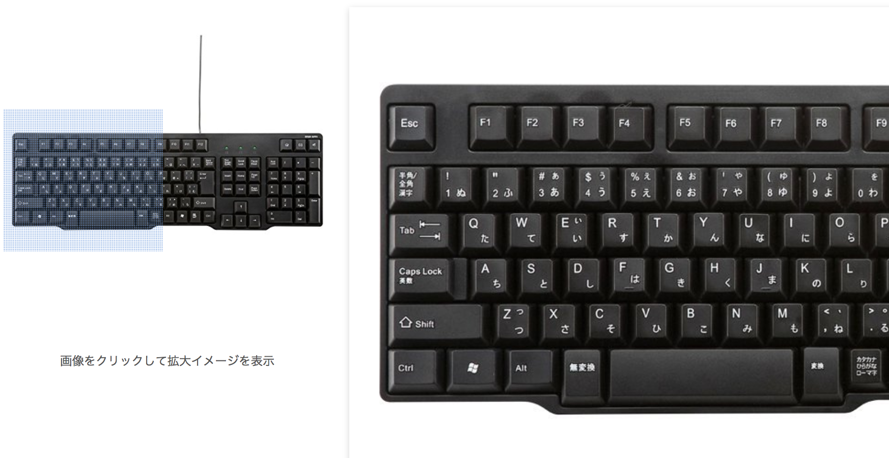
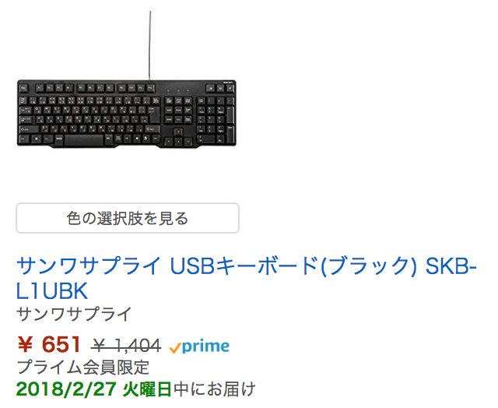
Upper-case Alphabet
is easy to type for small kids
https://www.amazon.co.jp/dp/B005LL9J9G/

Slide 78
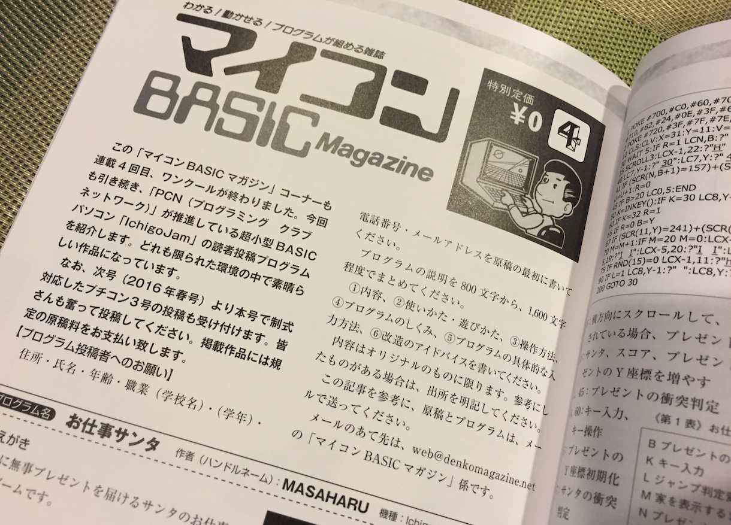
Challenge!
Got a prize 5,000yen!?

Slide 79
teaching
is the learning

Slide 80
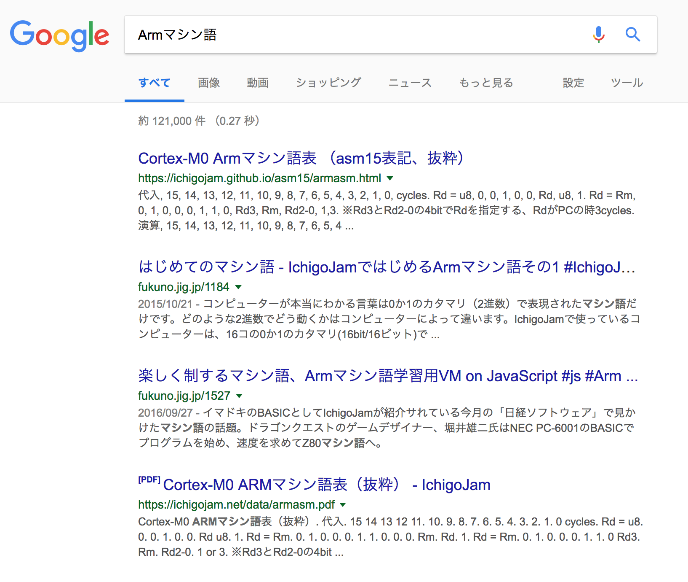
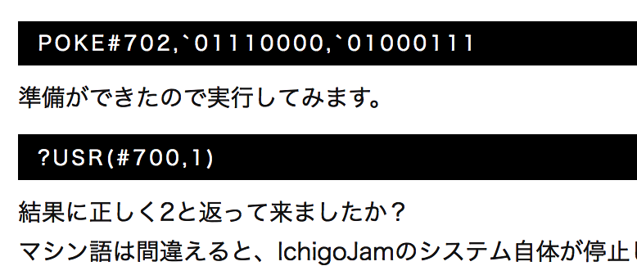
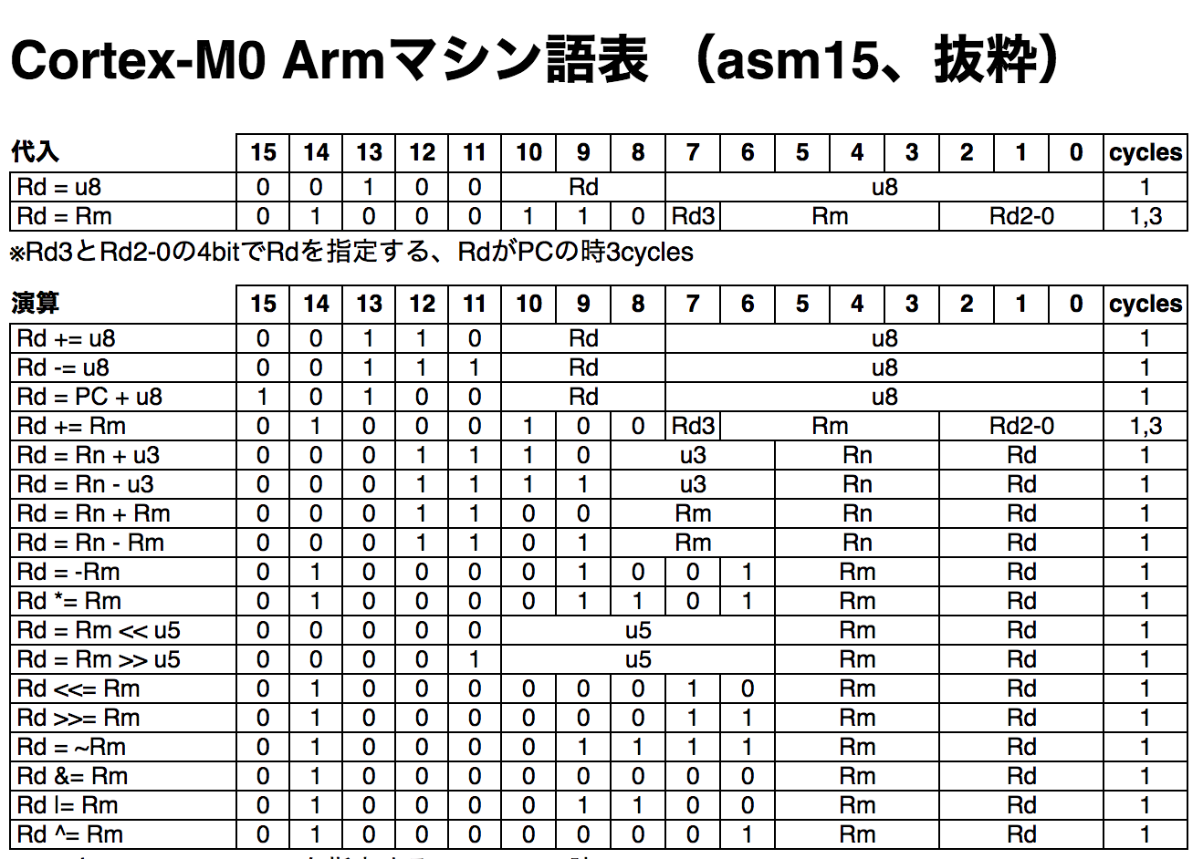
Too easy for you?
You can learn Assembly language also on IchigoJam
BASIC to Assembly
http://fukuno.jig.jp/1184
Arm articles (jp x12, en x2)

Slide 81
Kids in Japan don’t have own computer
age 13-15, rate of self owned computer
from JP-gov “内閣府「わが国と諸外国の若者の意識に関する調査」” (2013)

Slide 82
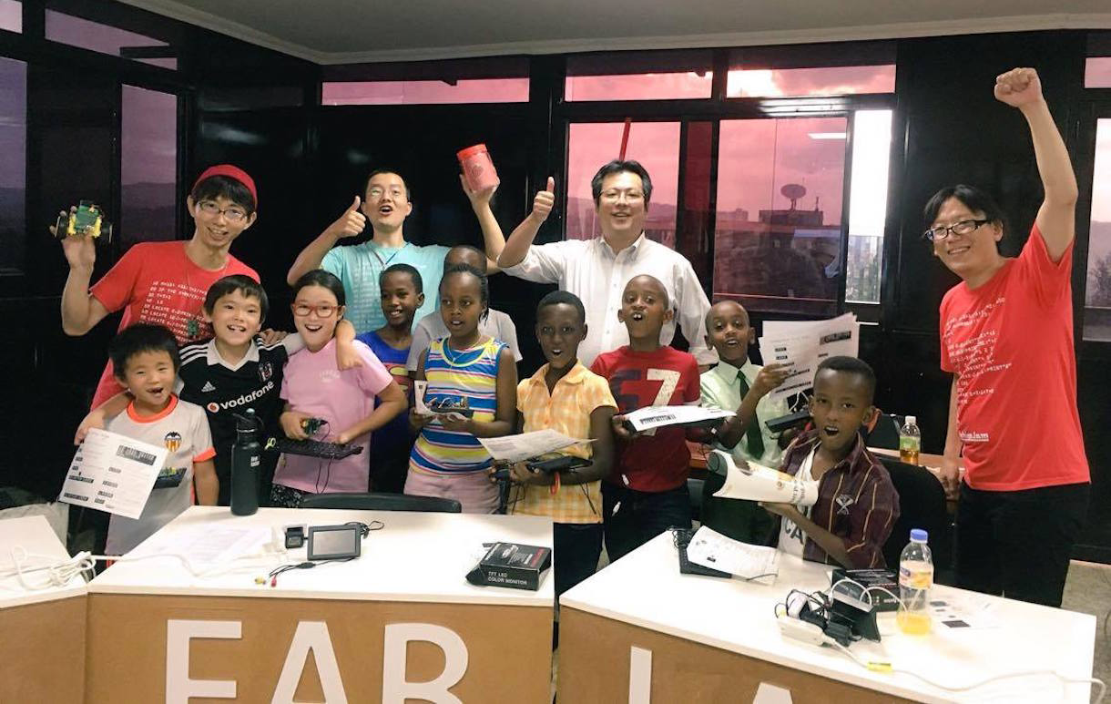
IchigoJam Workshop for Rwandan Kids
KidsVenture & PCN

Slide 83
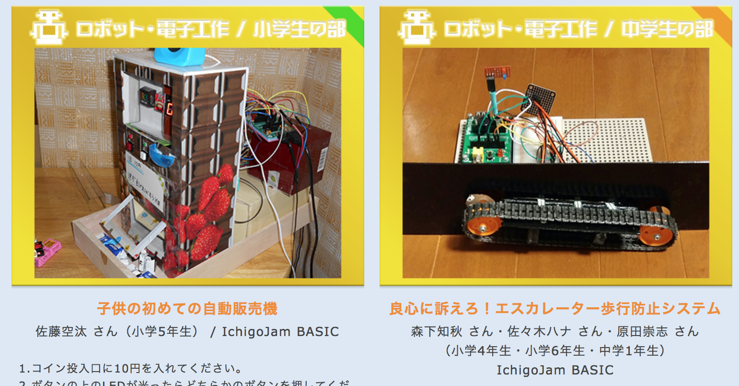
Challenge the Competition!
robots, electric works, programmings
PCNこどもプロコン
PCN Kids Programming Contest
http://pcn.club/contest/

Slide 84
We presented
Windows PC for winners!

Slide 85
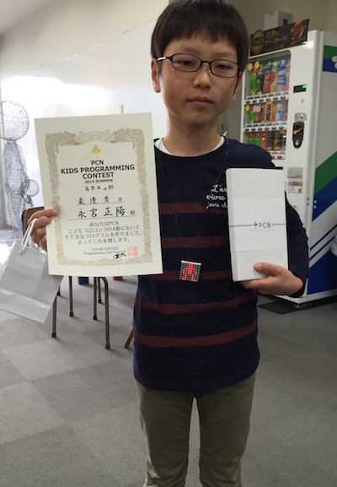
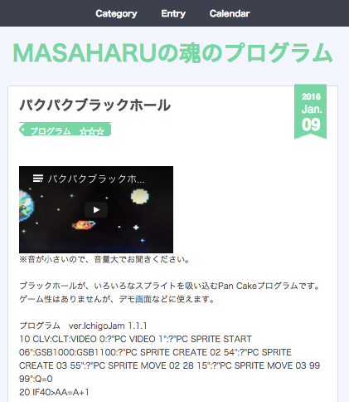
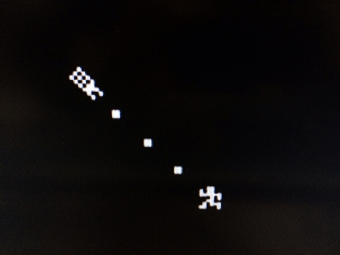
10 age programmer

Slide 86
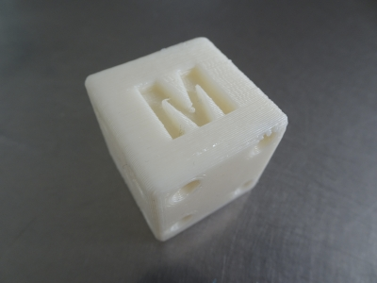
more computers for more funs
using 3D printer
Make Anything!
iPhone/Android Apps

Slide 87
Robot Contest for Kids in Fukui!
2018.11.25
http://kani-robocon.com/

Slide 88
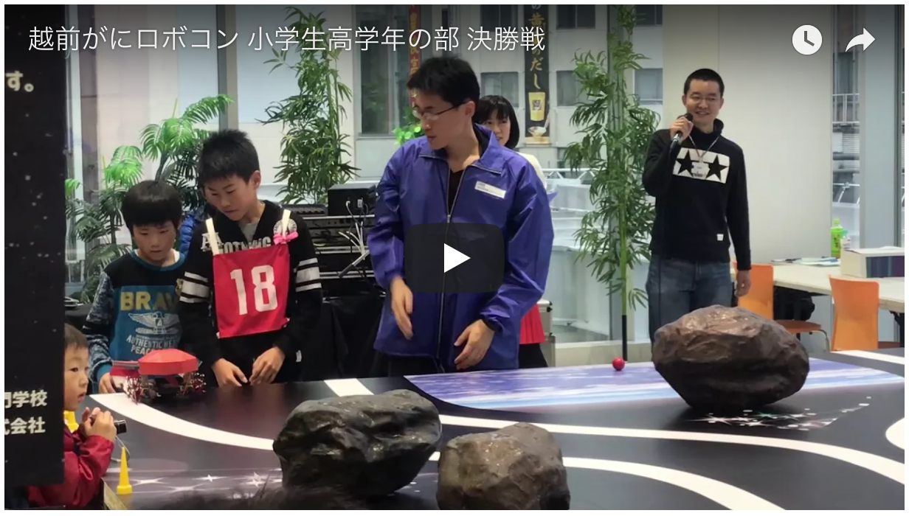
https://www.youtube.com/watch?v=ZapuZvRatKw

Slide 89
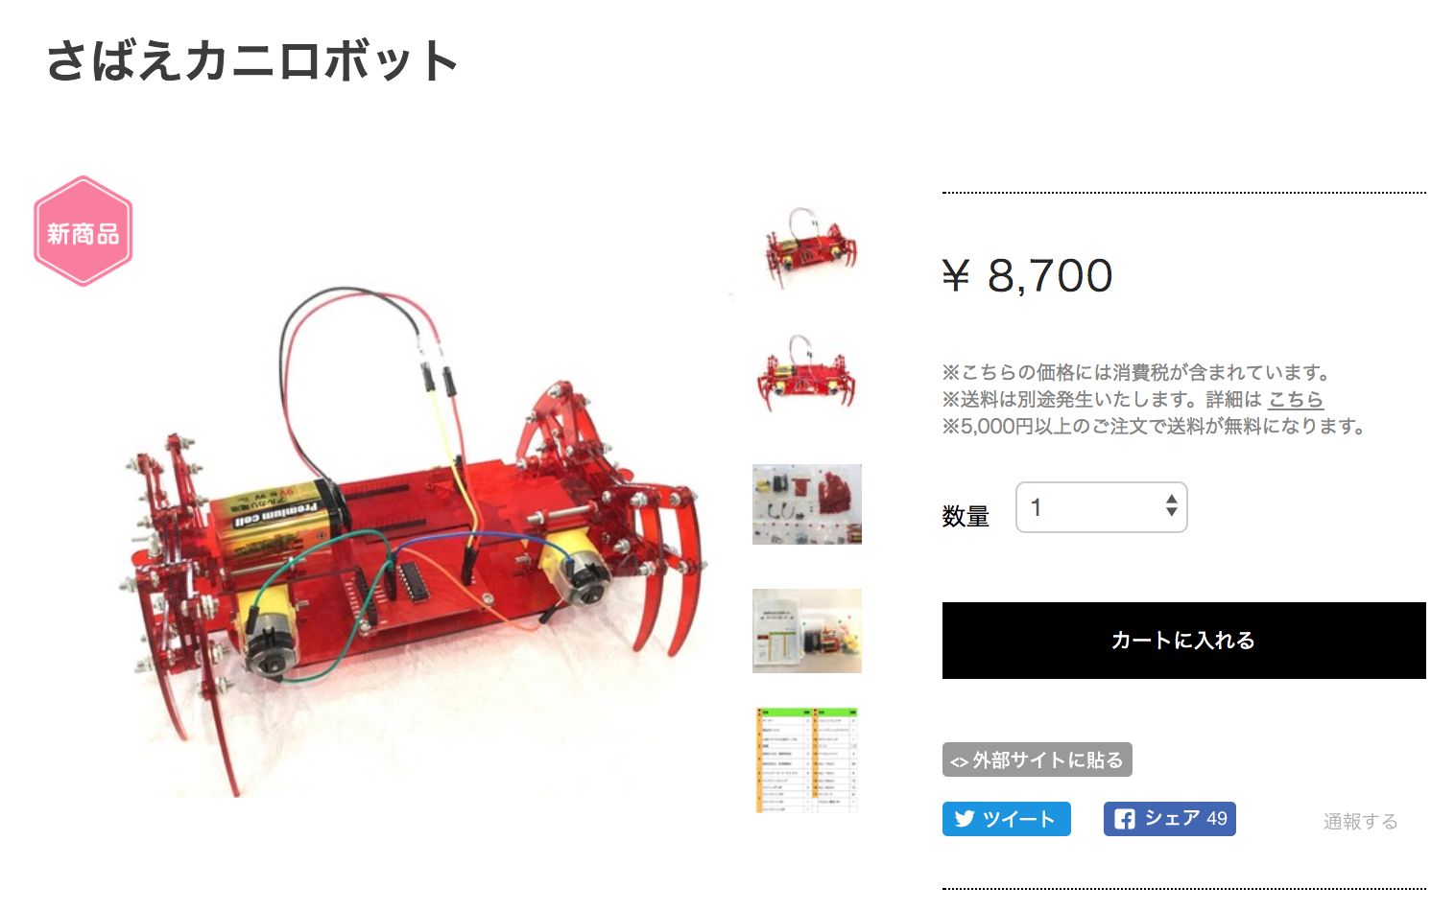
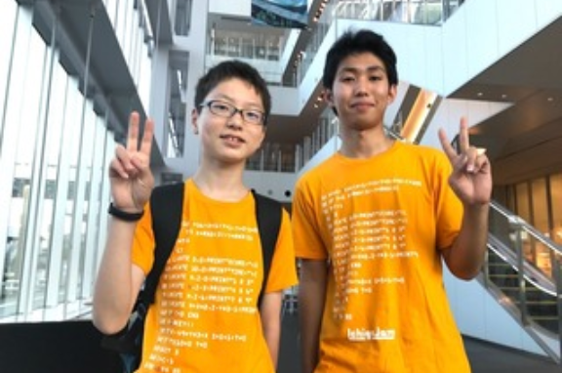
Developers of the crab robot kit
メカ担当：MASAHARU（中2）
基板担当：MISAKI（高２）
The product by kids belong Hana dojo at Sabae.
https://hanadojo.official.ec/items/8611440

Slide 90
A young leader of the new PCN branch in Fukui!
http://fukuno.jig.jp/2094

Slide 91
You can also make
own IchigoJam!
MangoJam for Philippines
SkyBerryJAM for Tochigi prefecture
http://www.tochigi-edu.ed.jp/tochigikogyo/nc2/index.php?page_id=212
https://yrm006.wordpress.com/2018/06/22/ichigojams-creator-fukuno-has-evangelized-programming-at-the-philippines-started-pcn-philippine-turlac-with-the-local-personal-computer-mangojam-ichigojam%E7%94%9F%E3%81%BF%E3%81%AE/

Slide 92
Programming for All Kids!
Let’s start PCN!
http://pcn.club/

